Slide 1
SSZG518: Database design and Applications Ms. Uma Maheswari

Slide 2
Session 11

Slide 3
LEARNING OUTCOME
Need for Concurrency Control in database systems
Lock-based protocols
Two-phase locking techniques for concurrency control
Deadlock situation
Timestamp-based protocols
REFER: T1-Chapter 18
Sections: 18.1, 18.2

Slide 4
Introduction to Concurrency
NEED FOR CONCURRENCY
To ensure that the Isolation Property is maintained while allowing transactions to execute concurrently (outcome of concurrent transactions should appear as though they were executed in isolation).
To preserve database consistency by ensuring that the schedules of executing transactions are serializable.
To resolve read-write and write-write conflicts among transactions.

Slide 5
Concurrency Control Protocols (CCPs)
A CCP is a set of rules enforced by the DBMS to ensure serializable schedules
Also known as CCMs (Concurrency Control Methods)
Main protocol known as 2PL (2-phase locking), which is based on locking the data items
Other protocols use different techniques
We first cover 2PL in some detail, then give an overview of other techniques

Slide 6
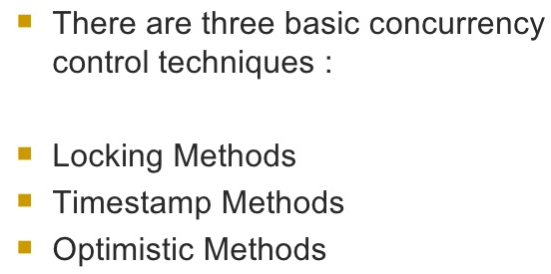
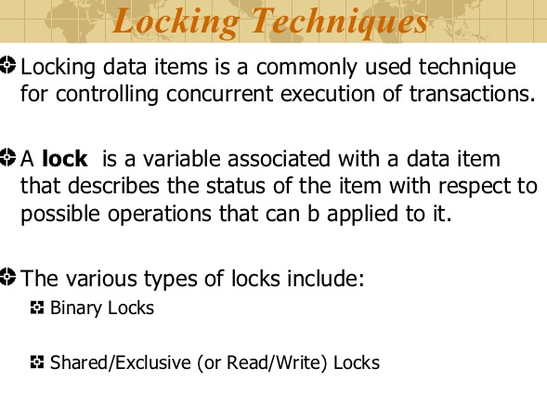
Concurrency Control

Slide 7
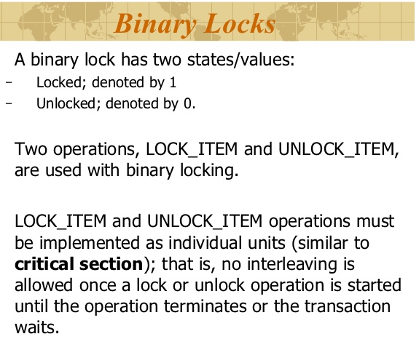
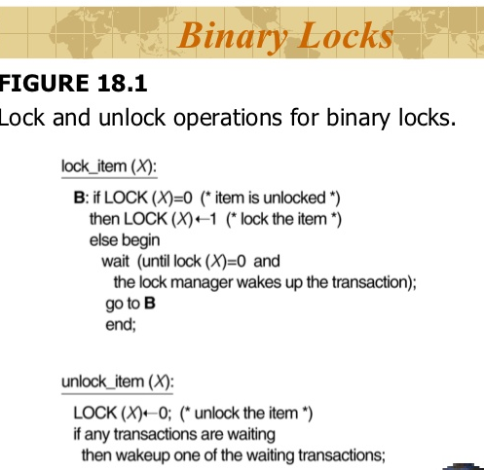
Binary Locks

Slide 8
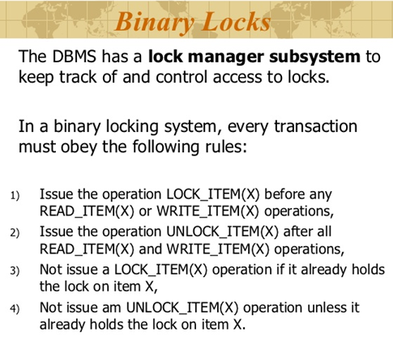
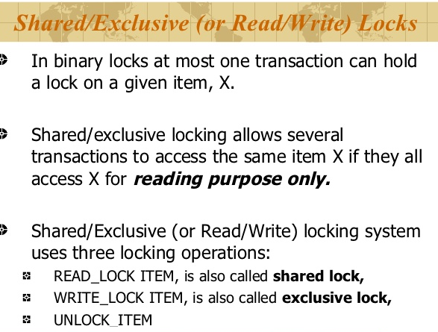
Binary and Xlocks

Slide 9
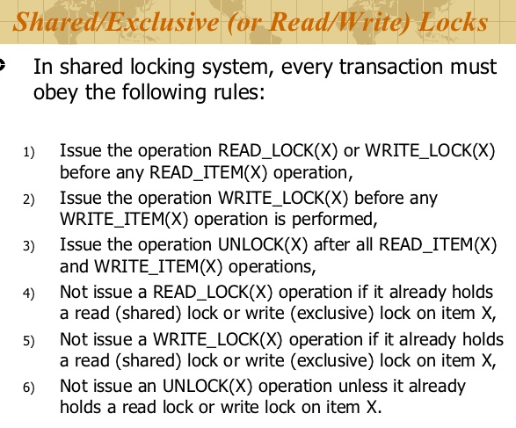
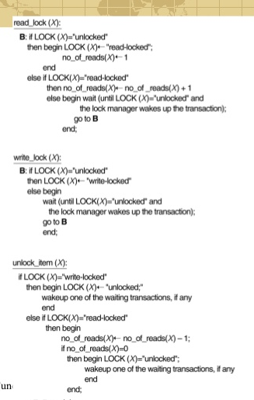
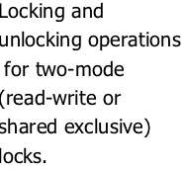
Shared locks

Slide 10
2PL Concurrency Control Protocol
Based on each transaction securing a lock on a data item before using it:
Locking enforces mutual exclusion when accessing a data item – simplest kind of lock is a binary lock, which secures permission to Read or Write a data item for a transaction.
Example: If T1 requests Lock(X) operation, the system grants the lock unless item X is already locked by another transaction. If request is granted, data item X is locked on behalf of the requesting transaction T1.
Unlocking operation removes the lock.
Example: If T1 issues Unlock (X), data item X is made available to all other transactions.

Slide 11
2PL Concurrency Control Protocol
System maintains lock table to keep track of which items are locked by which transactions
Lock(X) and Unlock (X) are hence system calls
Transactions that request a lock but do not have it granted can be placed on a waiting queue for the item
Transaction T must unlock any items it had locked before T terminates
Next slides gives overview of lock and unlock operations

Slide 12
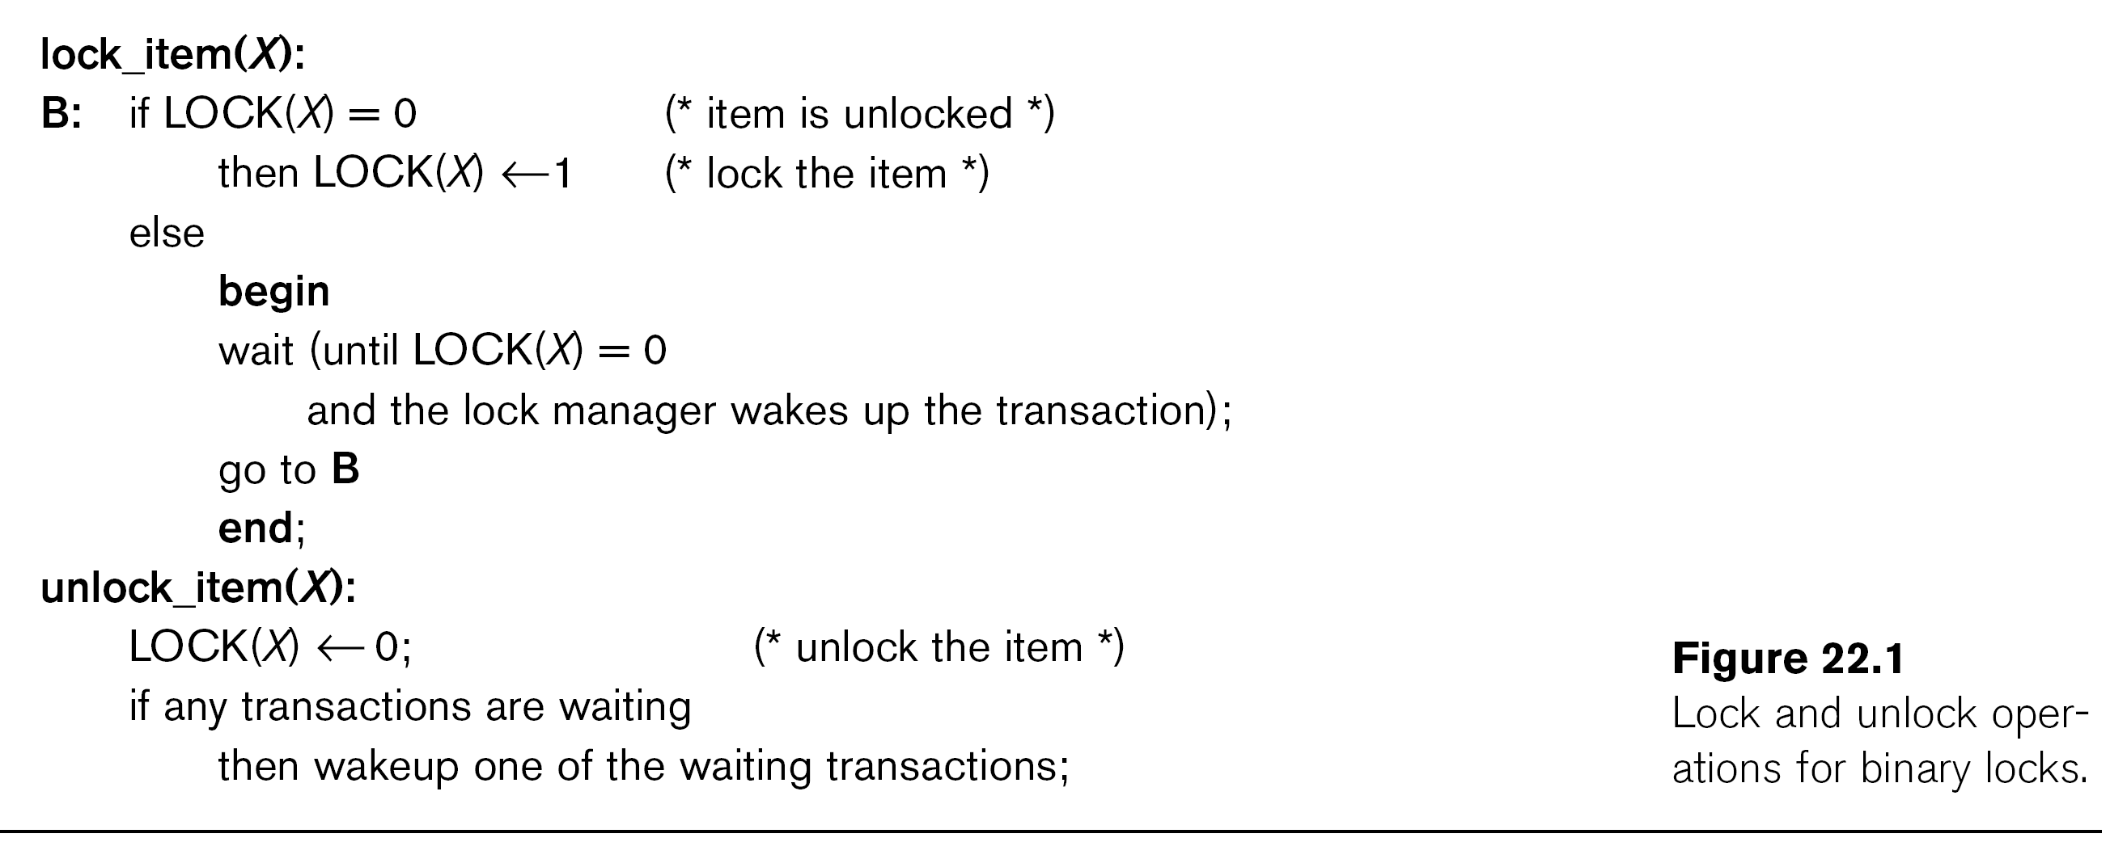
2PL Concurrency Control Protocol

Slide 13
2PL Concurrency Control
Locking for database items:
For database purposes, binary locks are not sufficient:
Two locks modes are needed
(a) shared lock (read lock) and (b) exclusive lock (write lock).
Shared mode: Read lock (X). Several transactions can hold shared lock on X (because read operations are not conflicting).
Exclusive mode: Write lock (X). Only one write lock on X can exist at any time on an item X. (No read or write locks on X by other transactions can exist).
Conflict matrix

Slide 14
2PL Concurrency Control
Three operations are now needed:
read_lock(X): transaction T requests a read (shared) lock on item X
write_lock(X): transaction T requests a write (exclusive) lock on item X
unlock(X): transaction T unlocks an item that it holds a lock on (shared or exclusive)
Transaction can be blocked (forced to wait) if the item is held by other transactions in conflicting lock mode
Conflicts are write-write or read-write (read-read is not conflicting)

Slide 15
2PL Concurrency Control
Two-Phase Locking Techniques: Essential components
Lock Manager: Subsystem of DBMS that manages locks on data items.
Lock table: Lock manager uses it to store information about locked data items, such as: data item id, transaction id, lock mode, list of waiting transaction ids, etc. One simple way to implement a lock table is through linked list (shown). Alternatively, a hash table with item id as hash key can be used.

Slide 16
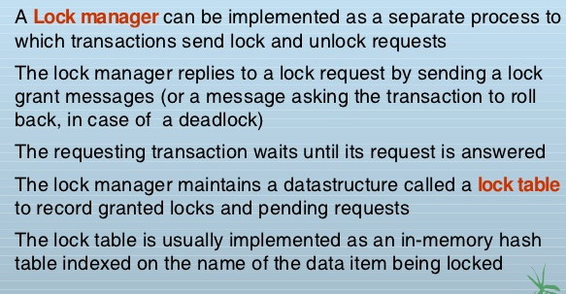
Lock manager

Slide 17
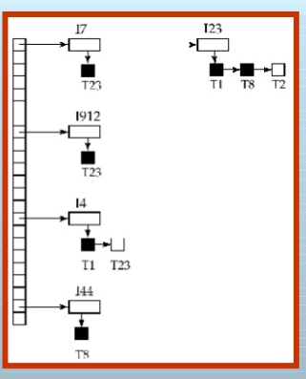
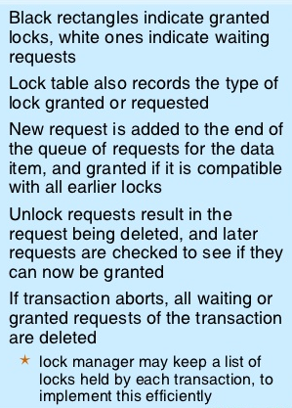
Lock table

Slide 18
2PL Concurrency Control
Rules for locking:
Transaction must request appropriate lock on a data item X before it reads or writes X.
If T holds a write (exclusive) lock on X, it can both read and write X.
If T holds a read lock on X, it can only read X.
T must unlock all items that it holds before terminating
(also T cannot unlock X unless it holds a lock on X).

Slide 19
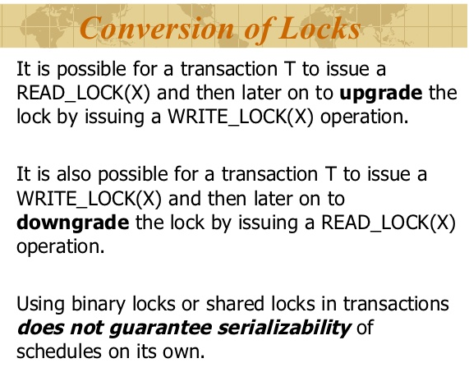
2PL Concurrency Control
Lock conversion
Lock upgrade: existing read lock to write lock
if Ti holds a read-lock on X, and no other Tj holds a read-lock on X (i ≠ j), then
it is possible to convert (upgrade) read-lock(X) to write-lock(X)
else
force Ti to wait until all other transactions Tj that hold read locks on X release their locks
Lock downgrade: existing write lock to read lock
if Ti holds a write-lock on X
(*this implies that no other transaction can have any lock on X*)
then it is possible to convert (downgrade) write-lock(X) to read-lock(X)

Slide 20
2PL Concurrency Control
Two-Phase Locking Rule:
Each transaction should have two phases: (a) Locking (Growing) phase, and (b) Unlocking (Shrinking) Phase.
Locking (Growing) Phase: A transaction applies locks (read or write) on desired data items one at a time. Can also try to upgrade a lock.
Unlocking (Shrinking) Phase: A transaction unlocks its locked data items one at a time. Can also downgrade a lock.
Requirement: For a transaction these two phases must be mutually exclusively, that is, during locking phase no unlocking or downgrading of locks can occur, and during unlocking phase no new locking or upgrading operations are allowed.

Slide 21
2PL Concurrency Control
Basic Two Phase Locking:
When transaction starts executing, it is in the locking phase, and it can request locks on new items or upgrade locks. A transaction may be blocked (forced to wait) if a lock request is not granted. (This may lead to several transactions being in a state of deadlock – see later)
Once the transaction unlocks an item (or downgrades a lock), it starts its shrinking phase and can no longer upgrade locks or request new locks.
The combination of locking rules and 2-phase rule ensures serializable schedules
Theorem: If every transaction in a schedule follows the 2PL rules, the schedule must be serializable. (Proof is by contradiction.)

Slide 22
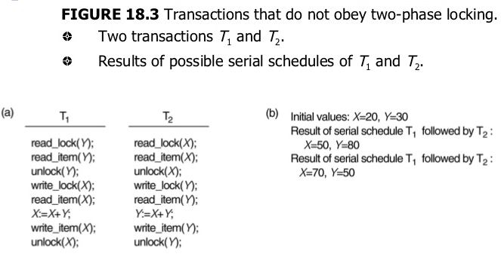
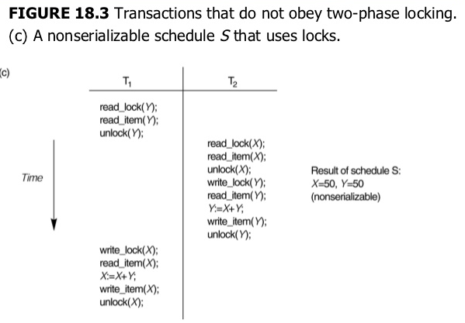
2 phase locking

Slide 23

2PL Concurrency Control
Other Variations of Two-Phase Locking:
Conservative 2PL: A transaction must lock all its items before starting execution. If any item it needs is not available, it locks no items and tries again later. Conservative 2PL has no deadlocks since no lock requests are issued once transaction execution starts.
Strict 2PL: All items that are writelocked by a transaction are not released (unlocked) until after the transaction commits. This is the most commonly used two-phase locking algorithm, and ensures strict schedules (for recoverability).
Rigorous 2PL: All items that are writelocked or readlocked by a transaction are not released (unlocked) until after the transaction commits. Also guarantees strict schedules.

Slide 24

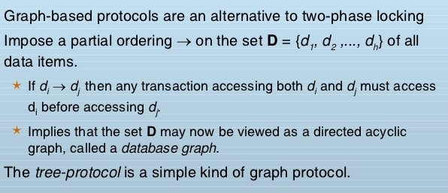
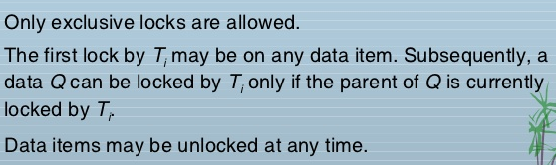
Graph based Locking

Slide 25
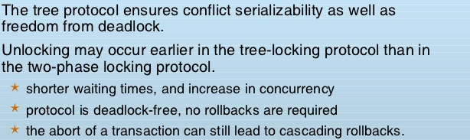
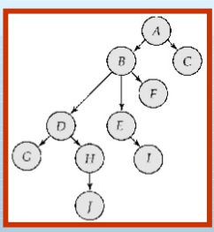
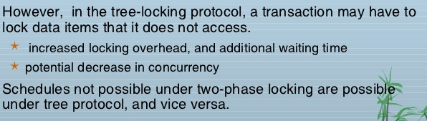
Tree protocol

Slide 26
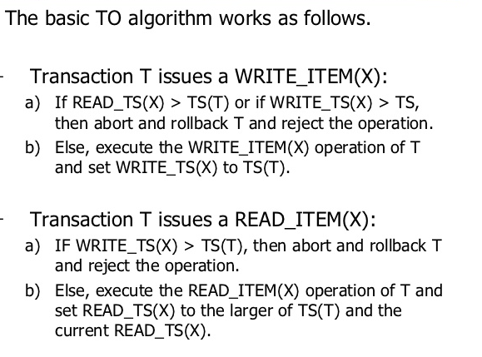
Timestamps protocol
WHAT IS TIMESTAMP?
The most commonly used concurrency protocol is the timestamp based protocol. This protocol uses either system time or logical counter as a timestamp.
Lock-based protocols manage the order between the conflicting pairs among transactions at the time of execution, whereas timestamp-based protocols start working as soon as a transaction is created.
Every transaction has a timestamp associated with it, and the ordering is determined by the age of the transaction. A transaction created at 0002 clock time would be older than all other transactions that come after it.
For example, any transaction 'y' entering the system at 0004 is two seconds younger and the priority would be given to the older one.
In addition, every data item is given the latest read and write-timestamp. This lets the system know when the last ‘read and write’ operation was performed on the data item.

Slide 27
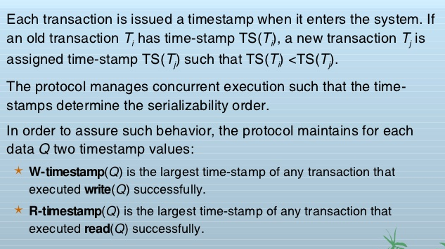
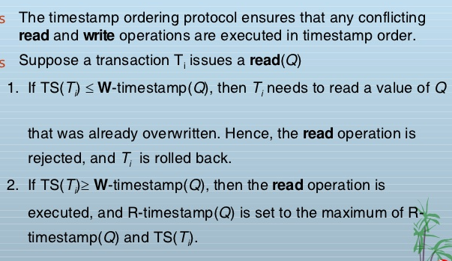
Timestamp based locking/ Protocol

Slide 28
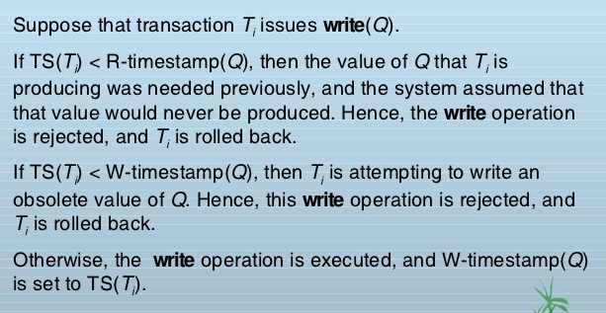
Timestamp based locking/ Protocol

Slide 29
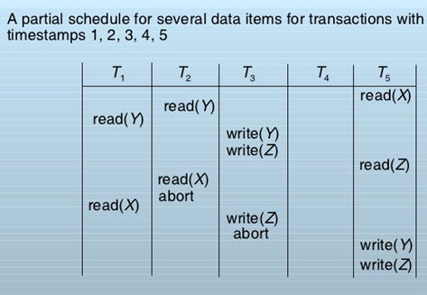
Example

Slide 30
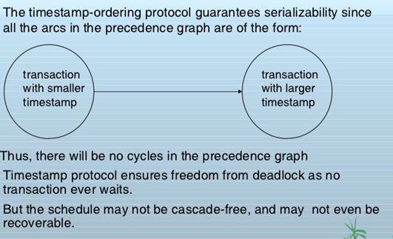
Correctness of timestamp ordering Protocol

Slide 31
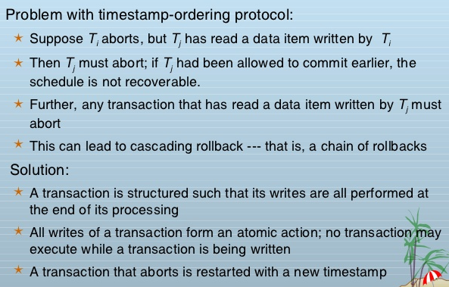
Recoverability and Cascade freedom

Slide 32
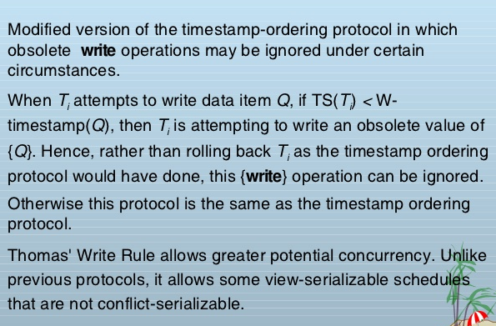
Thomas Write Rule

Slide 33
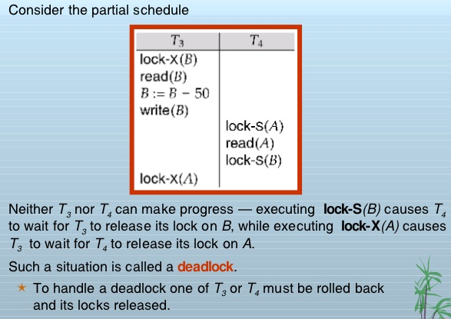
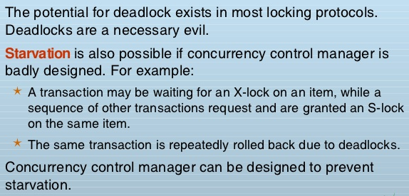
Deadlock and starvation

Slide 34
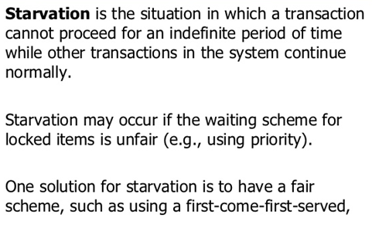
Starvation

Slide 35
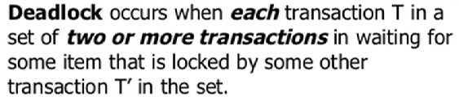
Deadlocks
In a multi-process system, deadlock is an unwanted situation that arises in a shared resource environment, where a process indefinitely waits for a resource that is held by another process.
For example, assume a set of transactions {T₀, T₁, T₂, ...,T_{n}}. T₀ needs a resource X to complete its task. Resource X is held by T₁, and T₁ is waiting for a resource Y, which is held by T₂. T₂ is waiting for resource Z, which is held by T₀. Thus, all the processes wait for each other to release resources. In this situation, none of the processes can finish their task. This situation is known as a deadlock.
Deadlocks are not healthy for a system. In case a system is stuck in a deadlock, the transactions involved in the deadlock are either rolled back or restarted.
Deadlocks can be :
Prevented
Detected
3. Avoided

Slide 36
How do you simulate a deadlock?
CREATE TABLE t1 (i int); CREATE TABLE t2 (i int); INSERT t1 SELECT 1; INSERT t2 SELECT 9; /* in one window enter: */ BEGIN TRAN UPDATE t1 SET i = 11 WHERE i = 1 WAITFOR DELAY '00:00:20' UPDATE t2 SET i = 99 WHERE i = 9 COMMIT /* in a second window (another transaction) enter: */ BEGIN TRAN UPDATE t2 SET i = 99 WHERE i = 9 WAITFOR DELAY '00:00:20' UPDATE t1 SET i = 11 WHERE i = 1 COMMIT
BEGIN TRANS
Update or delete or insert ..
END
Note:
Locks are not released until a
ROLLBACK or COMMIT

Slide 37
Deadlock Prevention
Deadlock Prevention
To prevent any deadlock situation in the system, the DBMS aggressively inspects all the operations, where transactions are about to execute. The DBMS inspects the operations and analyzes if they can create a deadlock situation. If it finds that a deadlock situation might occur, then that transaction is never allowed to be executed.
There are deadlock prevention schemes that use timestamp ordering mechanism of transactions in order to predetermine a deadlock situation.
Wait-Die Scheme
In this scheme, if a transaction requests to lock a resource (data item), which is already held with a conflicting lock by another transaction, then one of the two possibilities may occur −
If TS(T_{i}) < TS(T_{j}) − that is T_{i}, which is requesting a conflicting lock, is older than T_{j} − then T_{i} is allowed to wait until the data-item is available.
If TS(T_{i}) > TS(t_{j}) − that is T_{i} is younger than T_{j} − then T_{i} dies. T_{i} is restarted later with a random delay but with the same timestamp.
This scheme allows the older transaction to wait but kills the younger one.

Slide 38
Wound-Wait Scheme
Wound-Wait Scheme
In this scheme, if a transaction requests to lock a resource (data item), which is already held with conflicting lock by some another transaction, one of the two possibilities may occur −
If TS(T_{i}) < TS(T_{j}), then T_{i} forces T_{j} to be rolled back − that is T_{i} wounds T_{j}. T_{j} is restarted later with a random delay but with the same timestamp.
If TS(T_{i}) > TS(T_{j}), then T_{i} is forced to wait until the resource is available.
This scheme, allows the younger transaction to wait; but when an older transaction requests an item held by a younger one, the older transaction forces the younger one to abort and release the item.
In both the cases, the transaction that enters the system at a later stage is aborted.

Slide 39
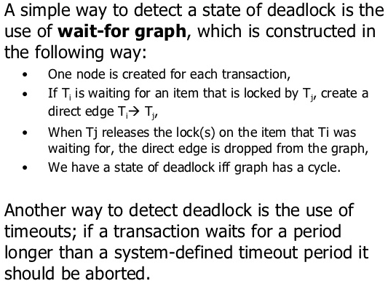
Deadlock Avoidance
Deadlock Avoidance
Aborting a transaction is not always a practical approach. Instead, deadlock avoidance mechanisms can be used to detect any deadlock situation in advance.
Methods like "wait-for graph" are available but they are suitable for only those systems where transactions are lightweight having fewer instances of resource.
In a bulky system, deadlock prevention techniques may work well.

Slide 40
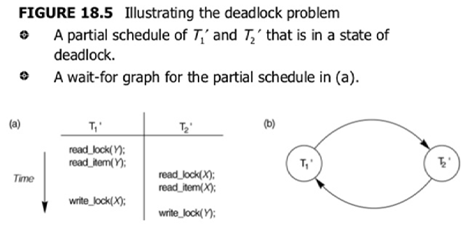
Deadlock Avoidance and recovery

Slide 41
Deadlock Avoidance and recovery
Here, we can use any of the two following approaches −
First, do not allow any request for an item, which is already locked by another transaction. This is not always feasible and may cause starvation, where a transaction indefinitely waits for a data item and can never acquire it.
The second option is to roll back one of the transactions. It is not always feasible to roll back the younger transaction, as it may be important than the older one. With the help of some relative algorithm, a transaction is chosen, which is to be aborted. This transaction is known as the victim and the process is known as victim selection.

Slide 42
Thank you

